Slide 1

TYPES OF SS TECHNIQUES
THE FUTURE LIES WITHIN

Slide 2
INTRODUCTION
•
There are four basic types classified according to the point of insertion of PN code
–
–
–
–
Direct Sequence spread spectrum (DSSS) Frequency hopping spread spectrum(FHSS) Time hopping spread spectrum (THSS) Hybrid techniques

Slide 3
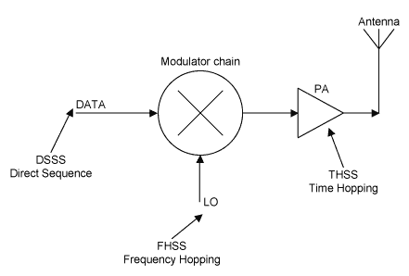

Slide 4
Direct Sequence SS
DSSS

Slide 5
DIRECT SEQUENCE SYSTEMS (DSSS)
•
It uses a locally generated pseudo noise code to encode digital data to be transmitted
The speed of the code sequence is called the chipping rate which is measured in cps
The amount of spreading is dependent upon the ratio of chips per bit of information (which is the processing gain Gp for DSSS)
A direct sequence modulator is then used to double sideband suppressed carrier modulate the carrier frequency to be transmitted The resultant DSB suppressed carrier AM modulation can also be thought of as binary phase shift keying (BPSK)
At the receiver, the information is recovered by multiplying the signal with a locally generated replica of the code sequence.
•
•
•
•

Slide 6
DSSS(CONTD)
INPUT:
dt is binary data with symbol rate Rs=1/Ts PNt is PN code with chip rate Rc=1/Tc
SPREADING:
TXb=dt.PNt
The effect of multiplication of dt with a PN sequence is to spread the baseband bandwidth Rs of dt to a baseband bandwidth of Rc.
DESPREADING:
Now TXb is received signal then Recovered data=dr=TXb.PNr When PNr=PNt
dr=(dt.PNt).PNt=dt

Slide 7
DSSS (Contd)
•
The effect of multiplication of the spread spectrum signal rxb with the PN sequence pnt used in the transmitter is to despread the bandwidth of rxb to Rs
•
If pnr ≠ pnt, than there is no despreading action. The signal dr has a spread spectrum. A receiver not knowing the PN sequence of the transmitter cannot reproduce the transmitted data (it will basically produce yet another version of the spectrum spread of the original signal - with a different code).
The multiplier output becomes:
dr = rxb · pnr = (dt · pnt ) · pnr
•

Slide 8
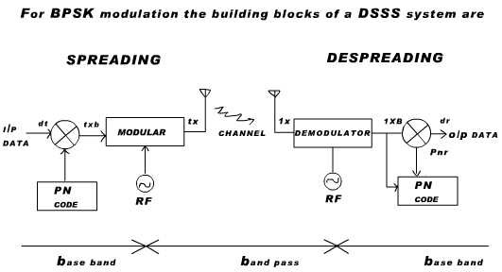

Slide 9
DSSS (contd)
•
ADVANTAGES
–
–
–
–
Simple hard ware implementation Best noise and anti jam performance Best discrimination against multi path
Do not require a high speed fast setting frequency synthesizer
•
DISADVANTAGES
–
–
–
–
Requires wide band channel with little phase distortion Long acquisition time.
Fast code generator needed. Near –far problem

Slide 10
Frequency Hoping Systems
FSSS

Slide 11
FREQUENCY HOPPING SYSTEMS
•
Carrier frequency shifting is discrete increments
in a pattern dictated by a code sequence. The transmitter jumps from frequency to frequency within some predetermined set; the order of
frequency usage is determined by a code sequence. A frequency hopped system, unlike direct sequence
one, can use both analog and digital carrier modulation and can be designed using conventional narrow band radio techniques
•

Slide 12
FHSS DETAIL
•
A pseudo-noise sequence pnt generated at the modulator is used in conjunction with an M-ary FSK modulation to shift the carrier frequency of the FSK signal pseudorandomly, at the hopping rate Rh
The transmitted signal occupies a number of frequencies in time, each for a period of time Th (=1/Rh), referred to as dwell time
FHSS divides the available bandwidth into N channels and hops between these channels according to the PN sequence
The transmitted bandwidth is determined by the lowest and highest hop positions and by the bandwidth per hop position
•
•
•

Slide 13
TYPES OF FHSS
•
Slow hopping:
–
The symbol rate Rs of MFSK signal is an integer multiple of the hop rate Rh. That is there are several symbols on each frequency hop.
Rs=nRh Where n is +ve
•
Fast hopping
–
The hop rate is an integer multiple of the symbol rate of MFSK that is in one symbol frequency will hop several times
Rh=nRs Where n is +ve

Slide 14
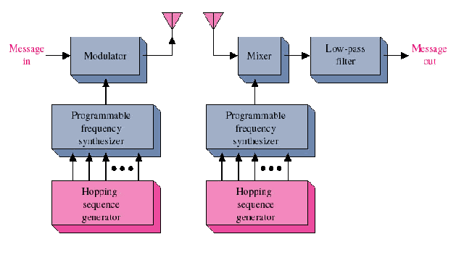
FHSS BLOCK DIAGRAM

Slide 15
FHSS (CONTD)
Advantages
–
–
Provide the greatest amount of spreading.
Can be arranged to avoid portions of the spectrum (i.e. those occupied by other systems or being the most affected by frequency selective fading)
Have a relatively short acquisition time because the chip rate is considerably less in the frequency hopping system.
It is not as much affected by the near far problem as DSSS is
–
–
Disadvantages
– Requires a complex frequency synthesizer in order to generate the hops
Always requires error correction.
Only the average power is spread; the narrowband interference is either eliminated completely or not reduced at all.
–
–

Slide 16
Time Hoping Systems
TSSS

Slide 17
TIME HOPPING SYSTEMS
•
A time hopping system is a spread spectrum system in which the period and duty cycle of a pulsed RF carrier are varied in a pseudorandom manner under the control of a coded sequence
Time hopped spread spectrum systems have found no commercial application to date. However, the arrival of cheap random access memory (RAM) and fast micro-controller chips make time hopping a viable alternative spread spectrum technique for the future.
Time hopping is a system in which burst signal are initiated at pseudo random rate. In this the transmitter is switched ON and OFF by a code sequence. The main difference between a frequency hopping and time hopping system is that in the former the transmitted frequency changes at each code chip time in the later the frequency changes occurs only at zero/ one transitions in the code sequence.
•
•

Slide 18
TRANSMISSION OF THSS
Storage Device
Modulator
 | S (t)
Time slot Activator
PN code Generator
Clock

Slide 19
THSS RECEIVER
On-off switches
Demodulator
PN code Generator
Bit timing
Clock VCO
Storage

Slide 20
THSS (contd)
•
Advantages
–
Has a high bandwidth efficiency as compared to FH and DSSS.
Its implementation is simpler than that of FHSS
Near-far problem can be avoided in a coordinated system
–
–
•
Disadvantages
–
–
Has a very long acquisition time. Also requires error correction

Slide 21
Hybrid Techniques
FHSS+THSS

Slide 22
HYBRID TECHNIQUES
•
Hybrid systems use a combination of spread spectrum methods in order to use the beneficial properties of the systems utilized. Two common combinations are direct sequence and frequency hopping. The advantage of combining the two methods is to capitalize on characteristics that are not available from a single method.

